Slide 1
APPLIED NUMERICAL FINANCE - 20247
A CROSS-LANGUAGE PROGRAM FOR PRICING REAL MARKET DATA
Alessandro Donno (1744747)

Slide 2



GETTING MARKET DATA FROM…

Slide 3
CHOOSE OPTION FLAVOR AND STRIKE PRICE AND THEN… TEST!
THREE DIFFERENT MODELS:
STANDARD BLACK-SCHOLES MODEL
JUMP-DIFFUSION PRICING MODEL
LOOKBACK OPTIONS PRICING MODEL

Slide 4
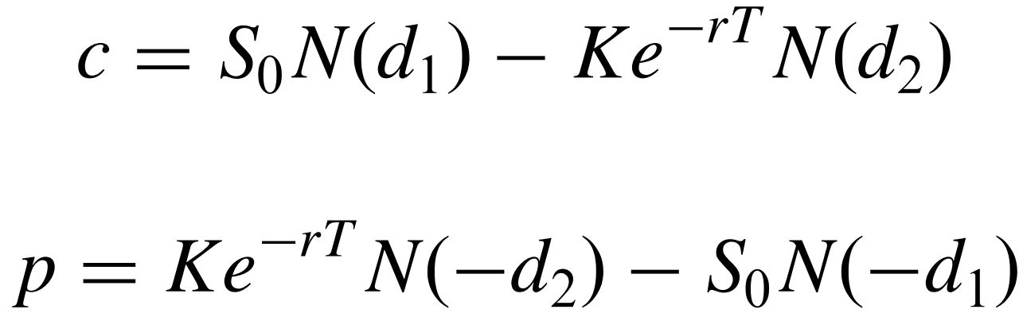
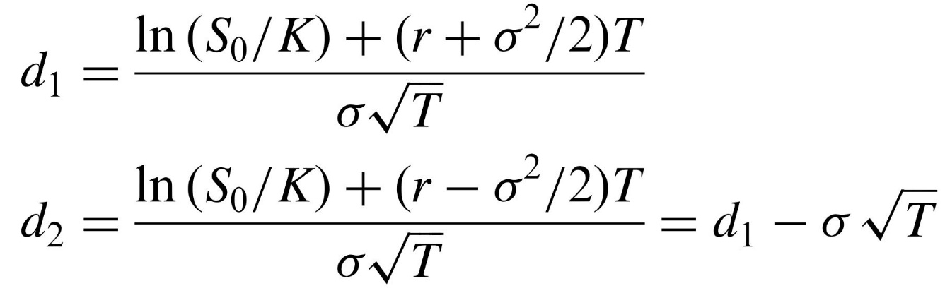
SETTING THE BLACK-SCHOLES FORMULAS

Slide 5
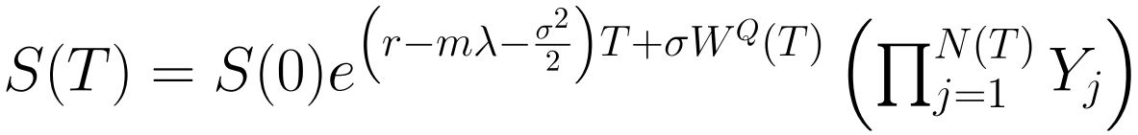
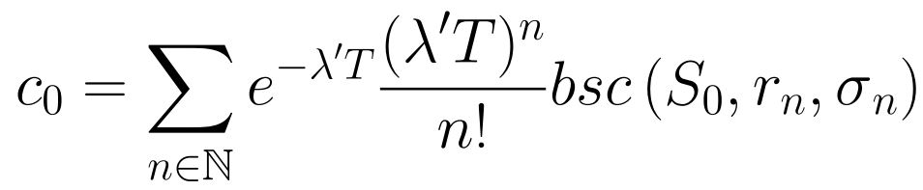
JUMP-DIFFUSION MODEL
Stock Price Dynamics:
Price of a Call option:

Slide 6




MONTE CARLO METHOD
Stock price dynamics under the standard GBM
1
2
3

Slide 7
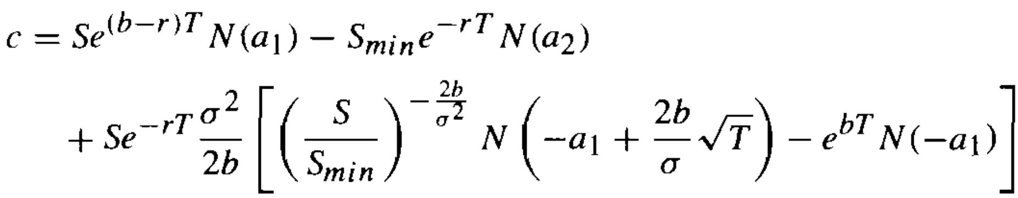
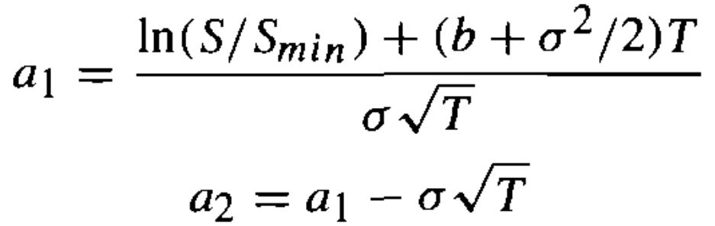
FLOATING-STRIKE LOOKBACK CALL OPTION

Slide 8
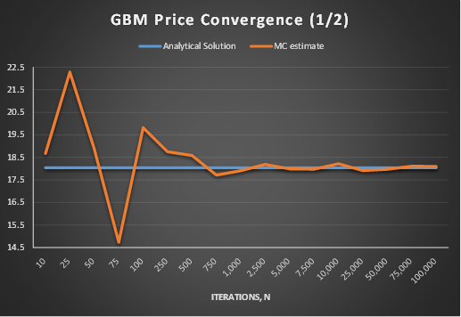
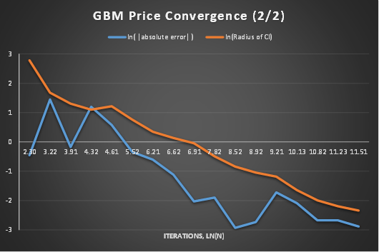
PRICE CONVERGENCE IN THE STANDARD GBM MONTE CARLO

Slide 9
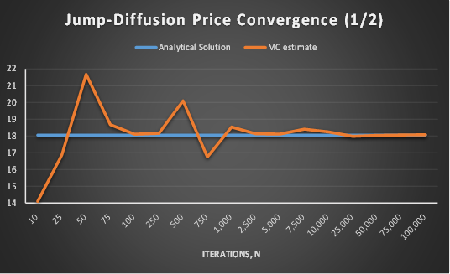
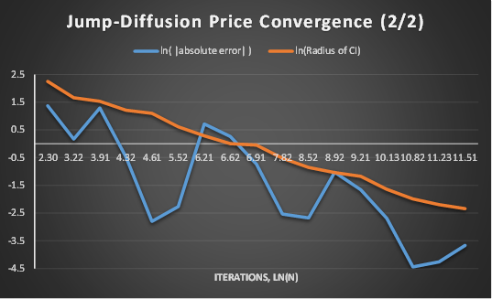
PRICE CONVERGENCE IN THE JUMP-DIFFUSION MONTE CARLO

Slide 10
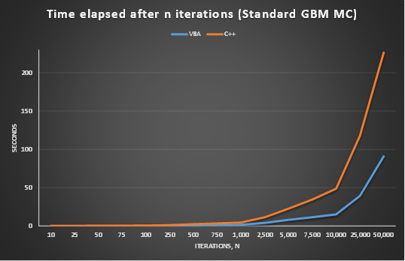
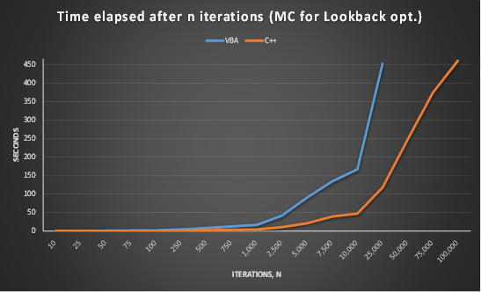
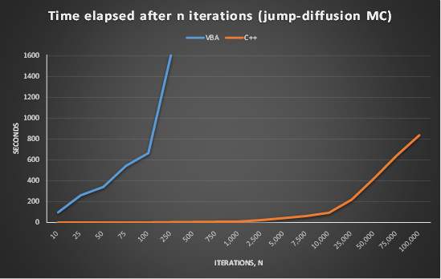
TIME REQUIREMENT FOR DIFFERENT MONTE CARLO SIMULATIONS IN VBA AND C++

